Slide 1
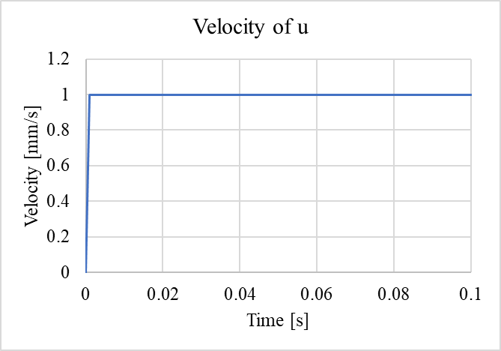
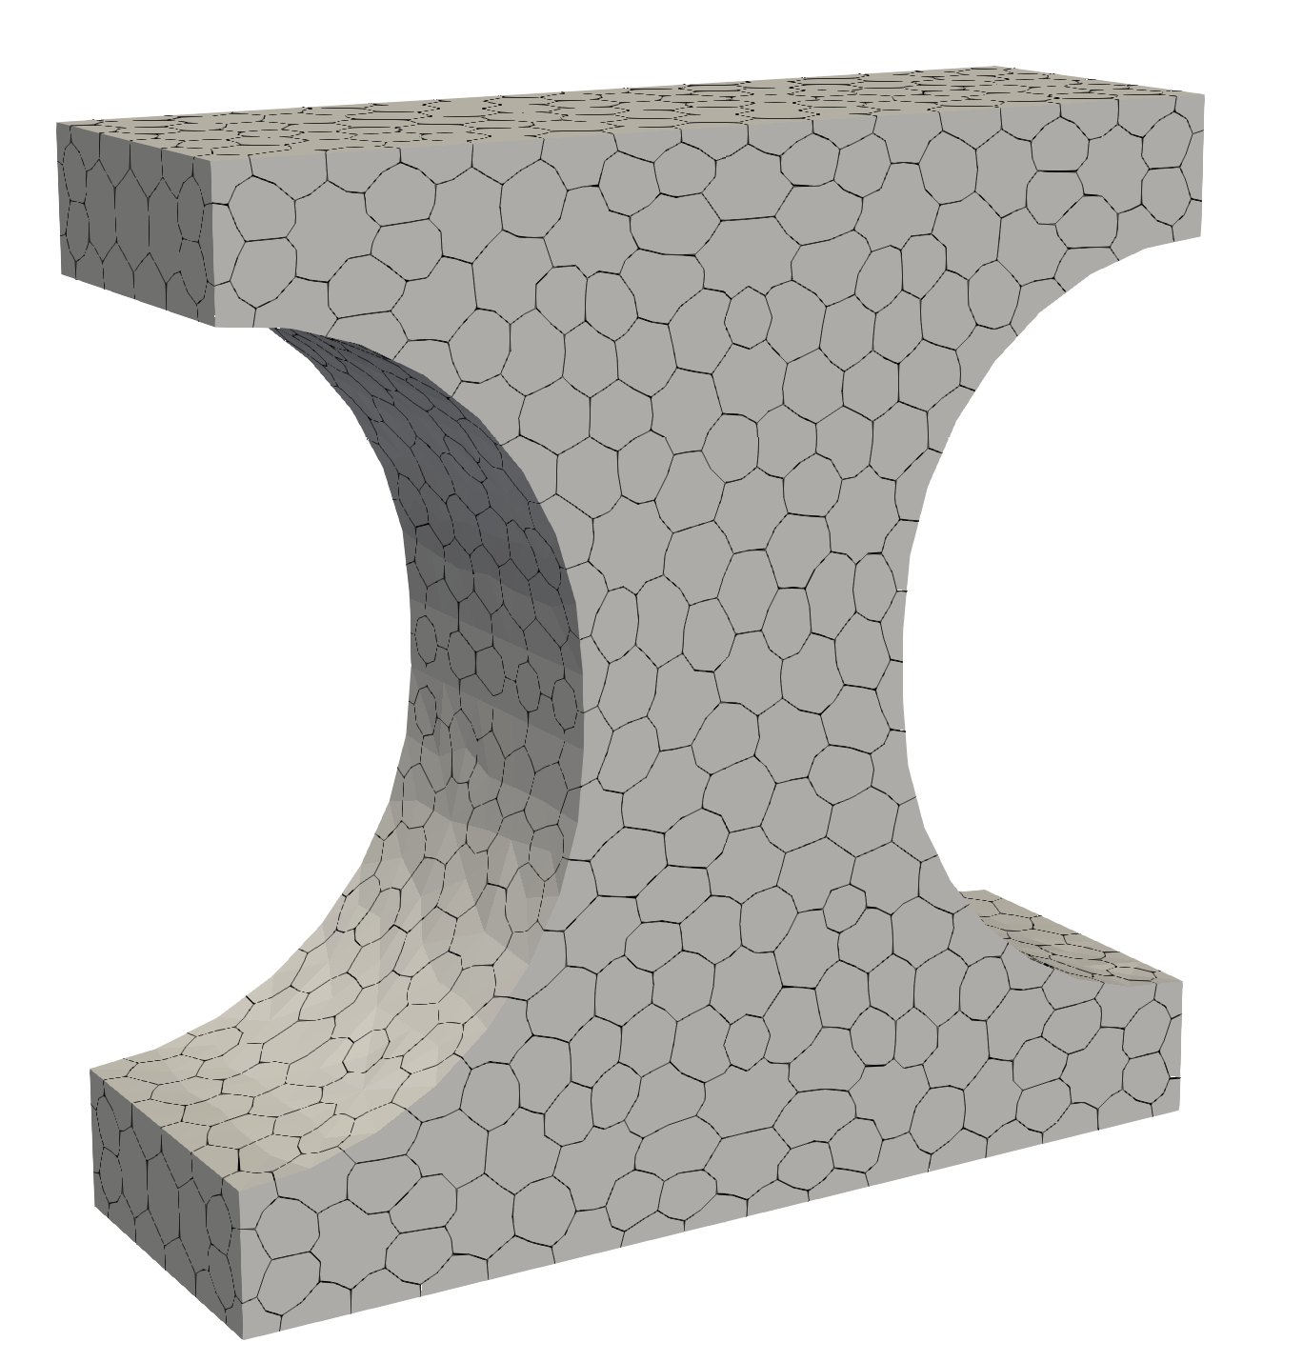
Dogbone Tensile Test
Size in XYZ: 150mm x 150mm x 50mm
RP1 :
(Central nodes at top)
dx = 0; dy = 0; dz = u;
rx = 0; ry = 0; rz = 0
RP2 :
(Central nodes at bottom)
dx = 0; dy = 0; dz = 0;
rx = 0; ry = 0; rz = 0
Tie:
RP1 -> nodes on the top (z=200)
RP2 -> nodes on the bottom (z=0)
dx, dy, dz, rx, ry are the same
RP1
0.001
Z
Y
X
RP2

Slide 2
P, u
B = 150mm
H = 150mm
D = 50mm
b = 50mm
H
b
Z
B
Y
D
X

Slide 3
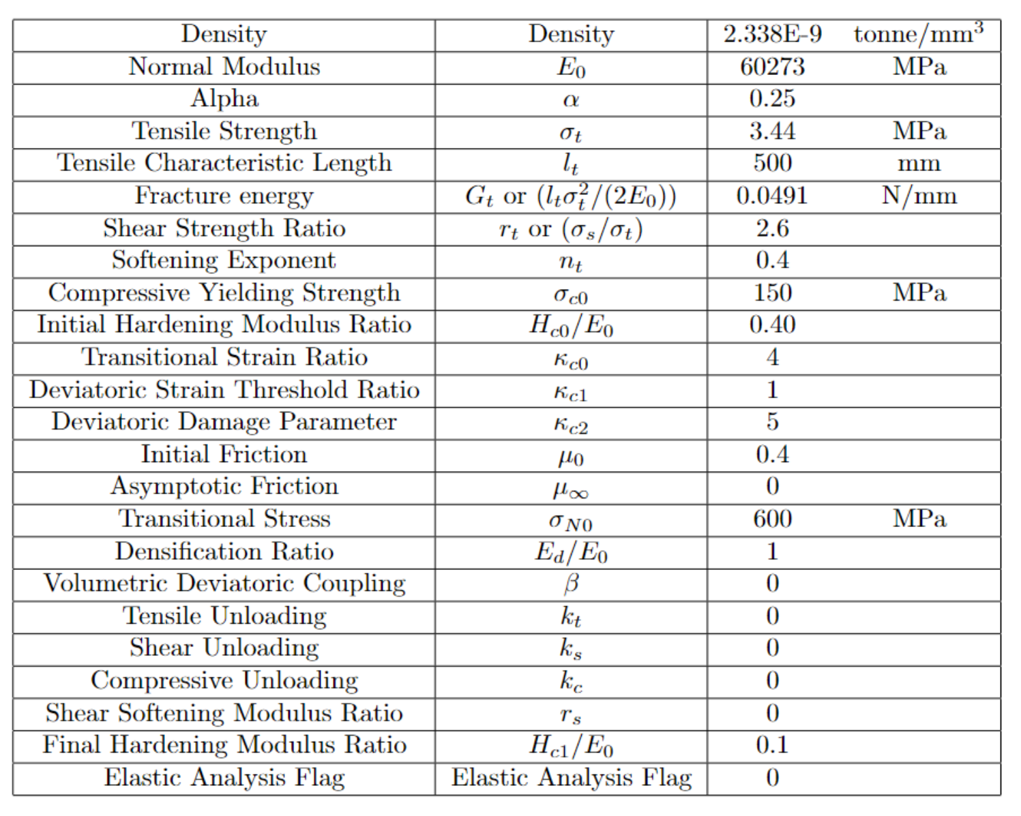
Material Property
Same as TPB test

Slide 4
